Slide 1
Name: Daniel Tanner
Age: 20
Major: Computer Science
Goal: Manage coursework efficiently and stay organised
Key Characteristics
High achiever
Good at balancing multiple coursework
Wants to maximise productivity
Tech-savvy
"I have a lot on my plate, and I need a way to manage everything efficiently. Keeping track of my progress will help me stay on top."

Slide 2
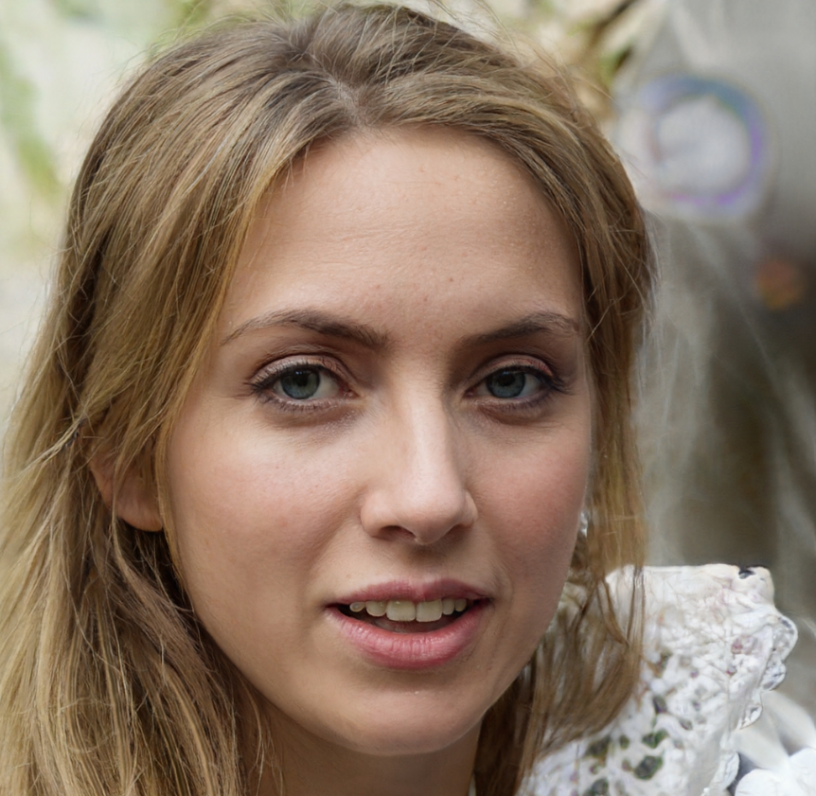
Name: Haley Scott
Age: 31
Major: MBA
Goal: Balance work and studies
Key Characteristics
Working post-grad student
Highly motivated
Struggles with balancing work and studies
Time constrains
"Balancing work and MBA is tough. I need a reliable system to track my coursework deadlines and manage my tasks, so that I don't fall behind."

Slide 3
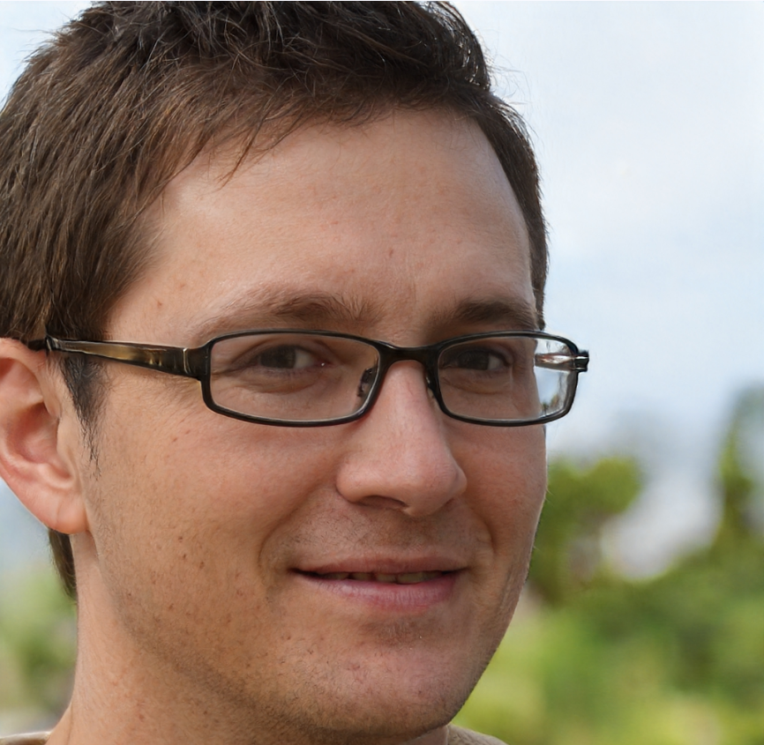
Name: Alex Gibbler
Age: 19
Major: BBA
Goal: Keep track of deadlines and task prioritisation
Key Characteristics
Average student
Forgets deadlines
Starts working last moment
Fails to prioritise tasks based on deadlines
Moderately tech-savvy
“Sometimes I forget deadlines and lose marks because of penalties. I need to prioritise my tasks and keep track of coursework deadlines."

Slide 4
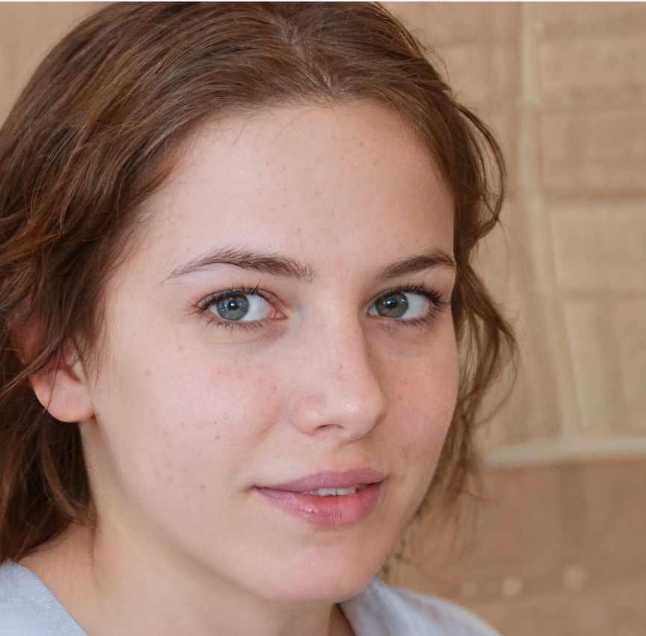
Name: Michelle Swift
Age: 22
Major: Psychology
Goal: Improve time management and reduce stress
Key Characteristics
Struggling student
Procrastinator
Poor time management
Misses deadlines all the time
“I worry about missing my deadlines. I need to keep track of everything so I can manage my time better and reduce stress."

Slide 5
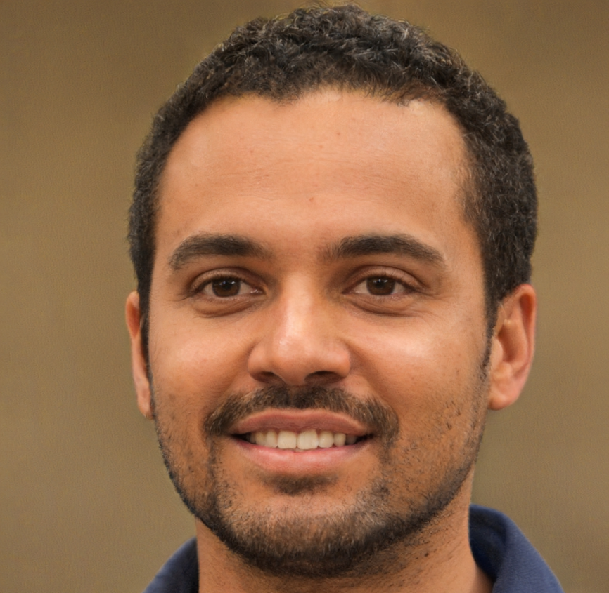
Name: Ahmed Ehab
Age: 30
Major: PhD in Engineering
Goal: Be consistent in research and manage teaching
Key Characteristics
Research assistant
Part-time lecturer
Organised but overloaded
Works late nights
Passionate researcher
“I enjoy my work, but I feel burnt out. It is difficult to research, teach and complete coursework at the same time. I need a system which can track deadlines and prioritise them."

Slide 6
Name: Dr. Arnold Jacob
Age: 52
Department: Maths
Goal: Manage and track performance and progress
Key Characteristics
Busy but organised
Moderately tech-savvy
Multiple classes and overloaded
Has many students with late submissions
“I need an easy way to upload coursework and set deadlines. Tracking student progress visually will help me identify who needs support."

Slide 7
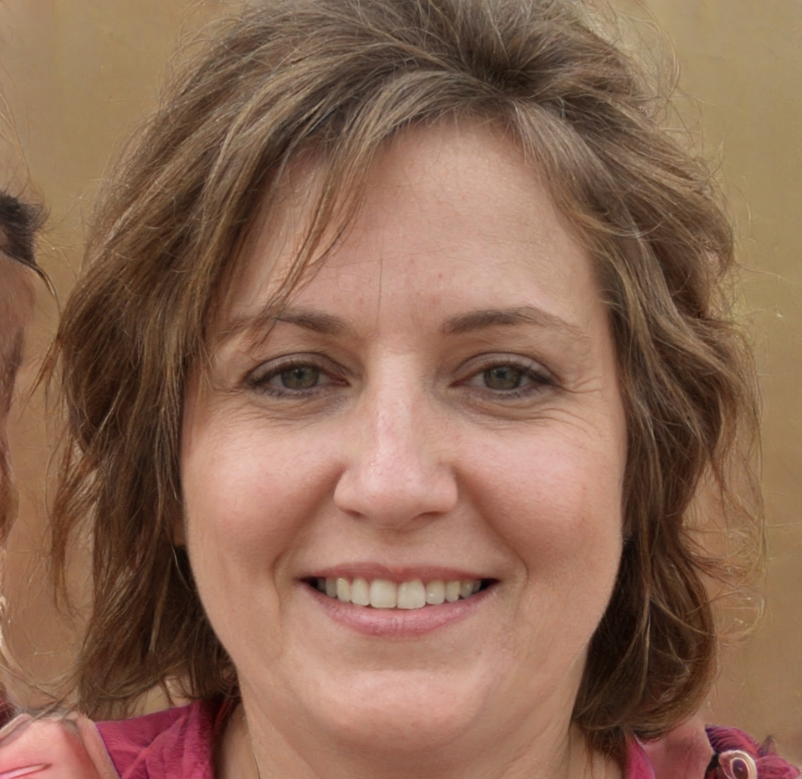
Name: Dr. Lisa Elvis
Age: 43
Department: History
Goal: Provide individual support to students
Key Characteristics
Supportive lecturer
Prioritises student needs
Learning technological tools
Likes to provide feedback
“I want to support my students individually, so I need to see their progress clearly. Sending personalized feedback will help them improve."

